Slide 1
DEBATE QUESTION
Was General Pershing’s embrace of open warfare tactics what World War I needed to end the stalemate, or did Pershing’s strategy lead to more U.S. casualties than there needed to be?

Slide 2
Analyzing the debate question
What is open warfare?
What is a stalemate?

Slide 3
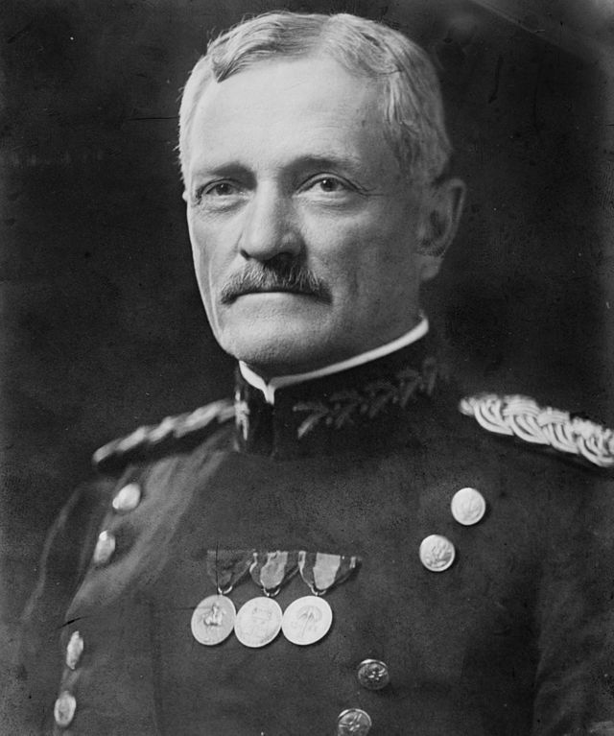
U.S. General John J. Pershing
early in military career, served in 6th U.S. Cavalry, roamed Great Plains, participated in skirmishes with Indian tribes
grew to favor hand-to-hand, rush-forward combat over trench warfare
Fighting in trenches caused soldiers to rely too heavily on machine guns, grenades, and artillery, which weakened will to fight.

Slide 4
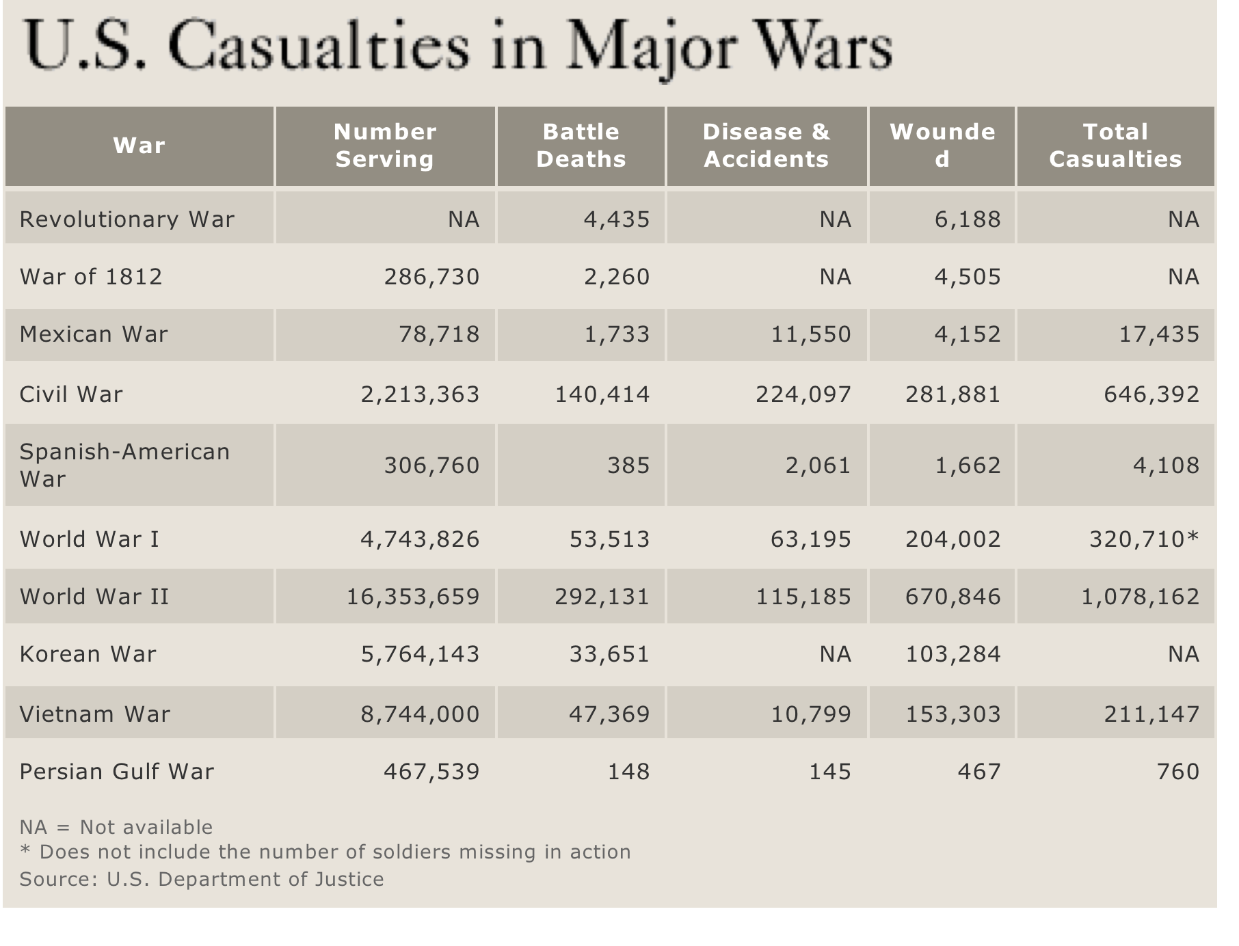
Did Pershing’s open warfare strategy lead to more U.S. casualties than there needed to be?

